Slide 1
CpE111
Introduction to Computer Engineering
Dr. Minsu Choi
CH 10: Computer Basics

Slide 2
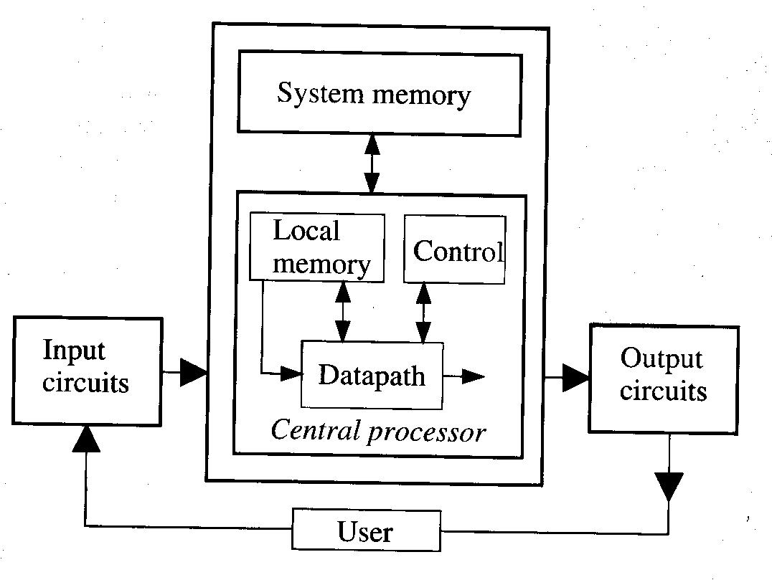
Major Components of a Computer
Input Networks: keyboard, mouse, etc,. provides input data to the computer.
Output Networks: monitor, printer, etc,. -> 1 and 2 are called I/O (input/output) devices.
Memory: provides the data storage.
Datapath: represents the paths that the data follow during the processing events.
Control: the control unit is responsible for insuring that the data is sent to the correct set of processing circuits. -> 4 and 5 are usually grouped together to form the central processing unit (CPU).

Slide 3
What Can A Computer Do?
A computer can perform extremely complex tasks.
But the internal operational modes are surprisingly limited.
In general, a computer provides only two basic types of operations:
  Data movement.
  Binary operations (both logic and arithmetic).
Every operation that a computer can perform is called an instruction.
The group of instructions is called the instruction set.
The number and types of instructions are determined by the structure of the datapath.

Slide 4
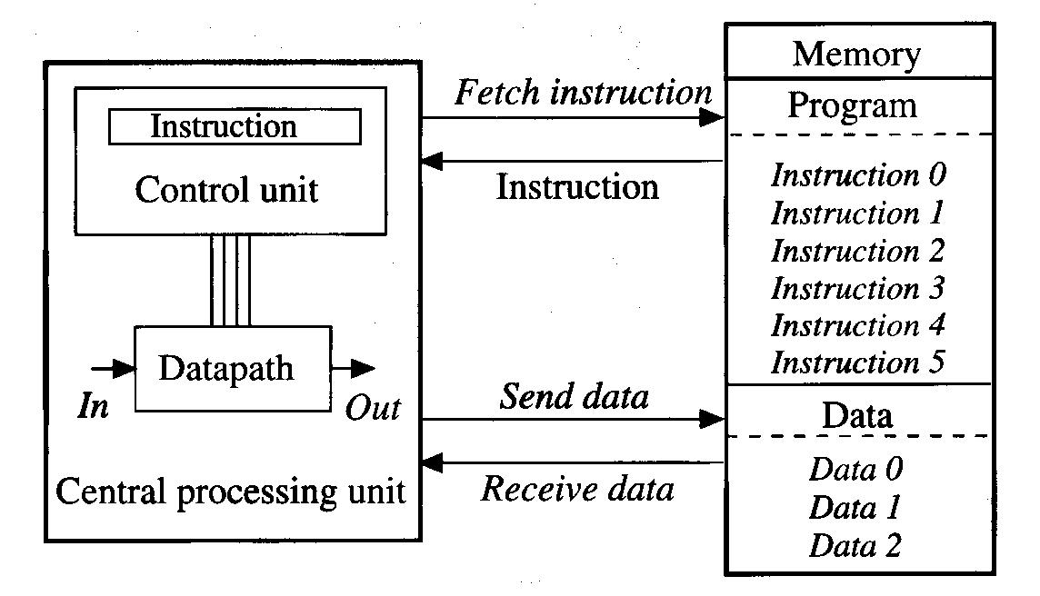
The von Neumann Model
Most computers are based on this model.
The main memory has program and data at the same time.
CPU fetches and executes instructions sequentially.

Slide 5
4-Cycle Execution Procedure
Instruction fetch: from memory to instruction register.
Instruction decode: interpret the instruction and determine what needs to be done.
Instruction execute: execute the instruction – necessary data also accessed.
Storage: the results are stored back in the memory (if any).
One instruction requires a total time of t_{inst} = t_{IF} + t_{ID} + t_{EX} + t_{S}.
Obviously, a smaller value of t_{inst} implies a faster computer since more insts can be computed in a second.

Slide 6
Programming
High-level programming languages such as C or Java are used to program a computer.
  Program: an ordered list of commands that tell the sequence of operations to accomplish a specific task.
  Syntax: predefined manner in which commands are constructed.
  Machine language: computer executable binary code – it is quite cumbersome for humans to use.
  Compiler: a specific program which can translate high-level language programs into machine language codes.
  Assembly language: human-understandable representation of machine code.

Slide 7
The Central Processing Unit (CPU)
Instruction fetch network
  A program is a sequential listing of binary words.
  Each word provides the information needed by the logic networks to perform a specific operation.
  The size of a word depends on the computer.
  Ex) 32-bit computer

Slide 8
Continued,
  The PC indicates the location (address) of the instruction being fetched.
  The address is directed to memory.
  Corresponding inst is fetched and stored in IR.
  Do the rest of fetch-execution procedure.
  PC = PC + 4 and go to 1.

Slide 9
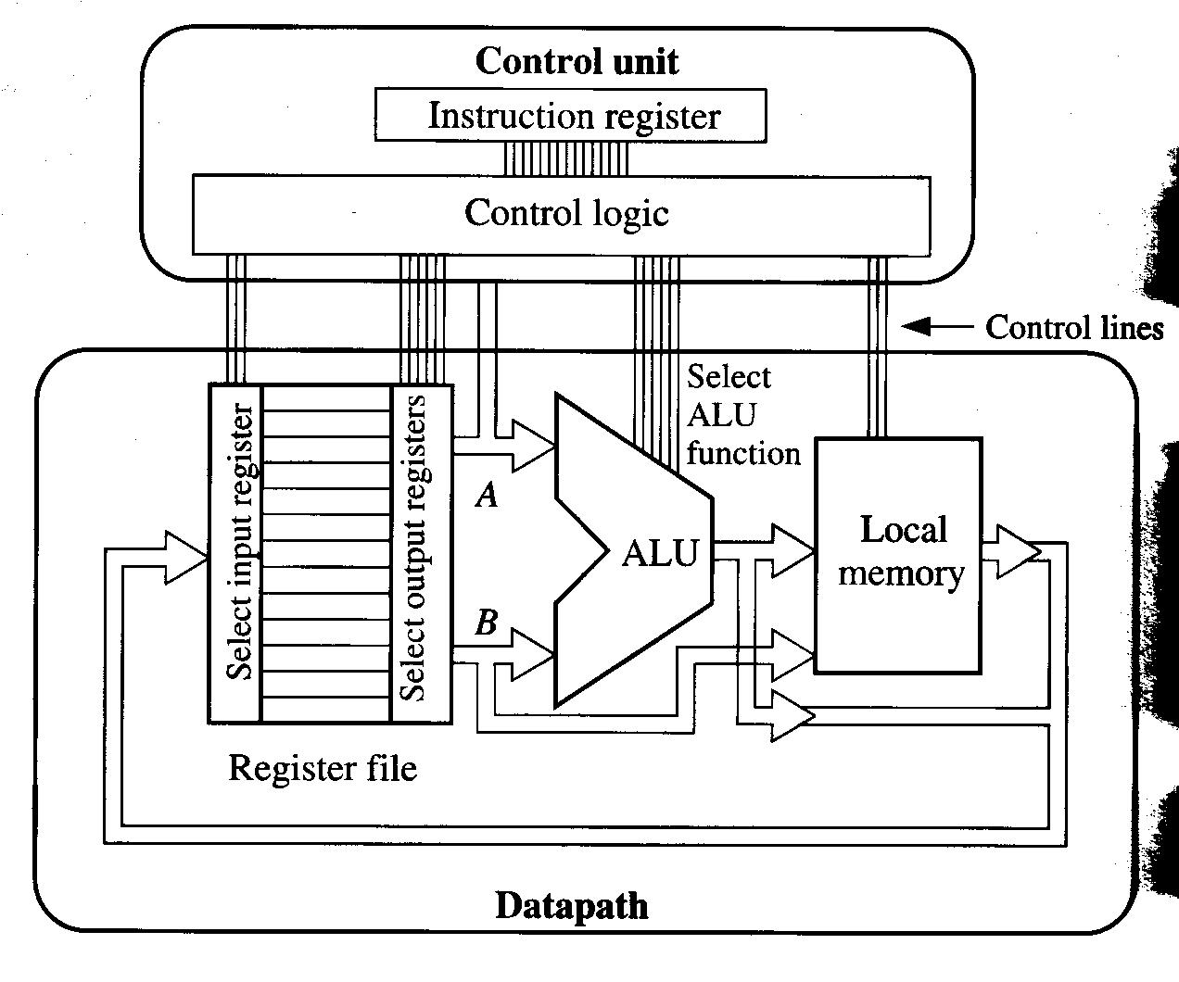
Concept of Datapath
Control unit consists of IR & control logic.
Datapath consists of reg file, ALU and local memory.

Slide 10
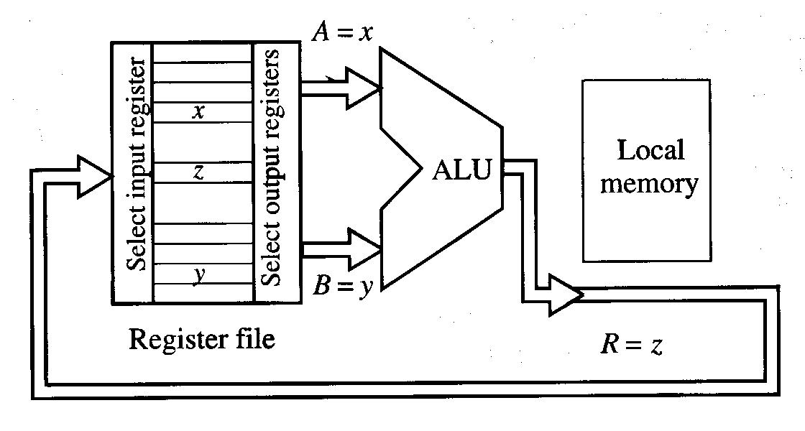
Datapath Operations
Reg-to-reg ops: Takes data words from the reg file (fast temporary storage for words) and uses them as inputs into the ALU. Then result is stored back into the reg file.

Slide 11
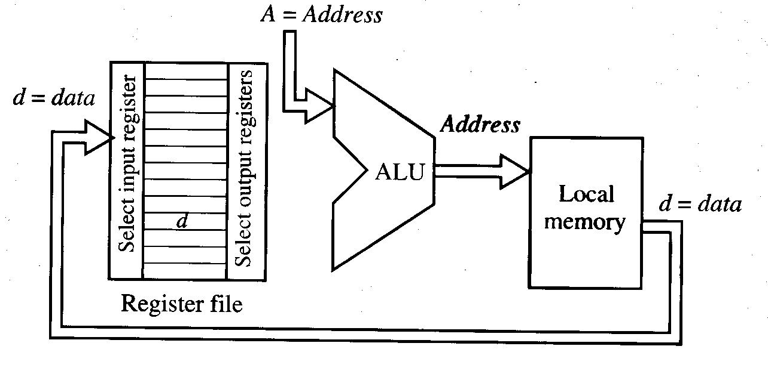
Continued,
Load op: Move data from local mem to register.
Ex) load word operation

Slide 12
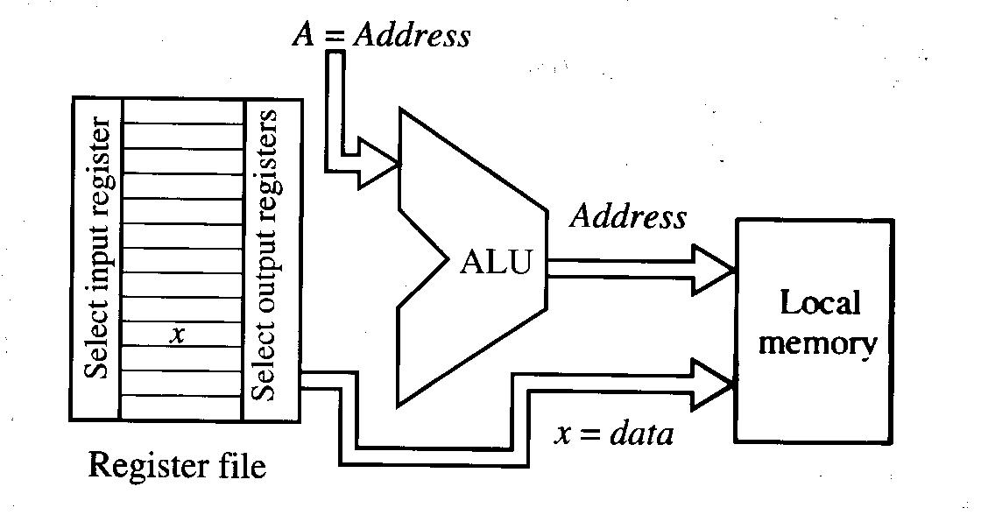
Continued,
Store op: move data from reg to mem.
Ex) store word operation

Slide 13
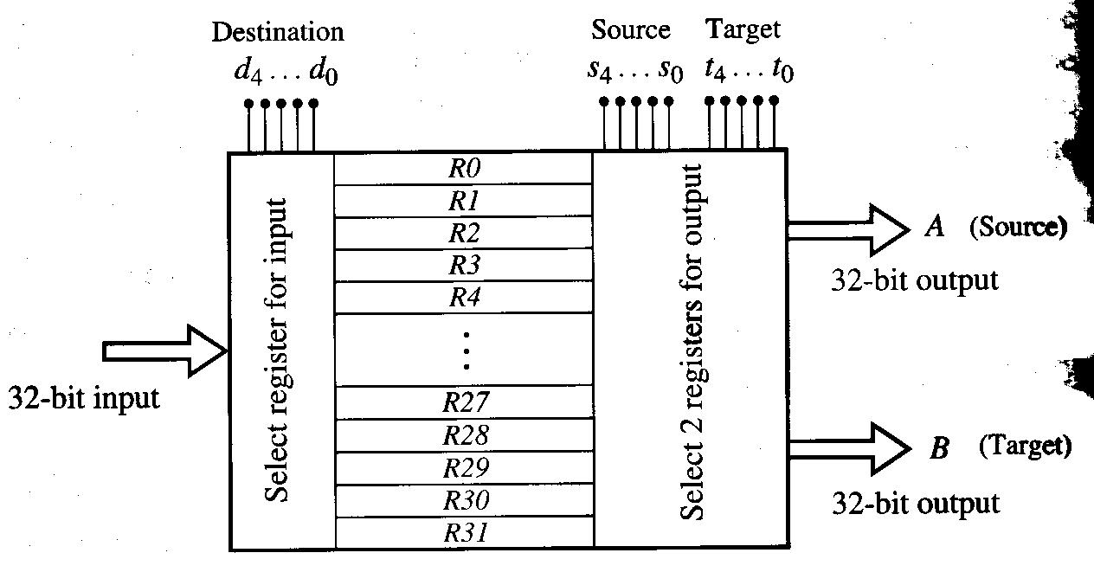
Datapath Components
Register file architecture: ex) 32-register RF.

Slide 14
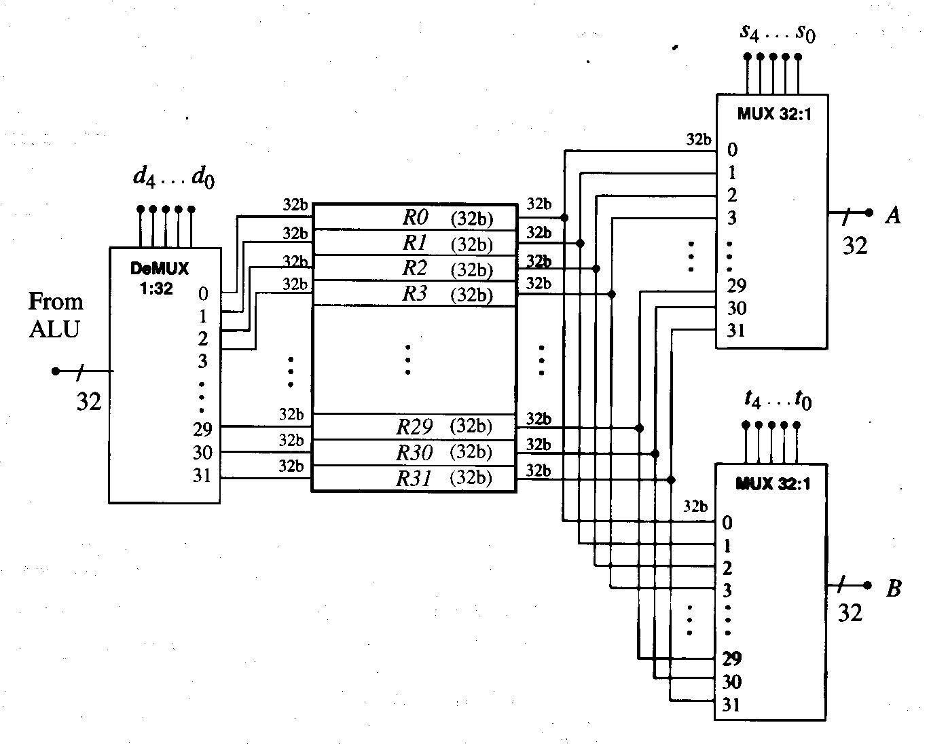
Unit-Level View of RF

Slide 15
Arithmetic and Logic Unit (ALU)
Provides both arithmetic functions and logic functions.
Ex) F=f₂f₁f₀

Slide 16
Parallel Structure of ALU
1-bit ALU is called “bit slice”.
A parallel grouping of 32 bit slices -> 32 bit ALU.

Slide 17
Ex) Sample ALU Bit-Slice Design

Slide 18
Concept of Local Memory (Cache)
CPU, in general, has local memory called cache memory.
Cache memory provides fast read/write storage.
But it is very small when compared to the size of the main memory.
Hierarchical arrangement of different storage units is referred to as the memory hierarchy.
If properly designed, considerable speed-up in read/write operations can be achieved.

Slide 19
Architecture
3 main components of CPU: register file, ALU and local memory.
  The ALU functions determine the type of arithmetic and logic ops that can be performed.
  The RF provides a set of fast local storage locations.
  The cache mem allows us to access to the large system memory.
The instructions that can be implemented on a given computer are determined by the properties of each unit and how they are connected to form the system -> called “instruction set architecture (ISA)”.

Slide 20
CISC & RISC Architectures
CISC:
  Complex instruction set computer.
  Instruction set has larger # of insts.
  Easy to program since various instructions are provided.
  But, hardware implementation is complex and execution time per inst is longer.
RISC:
  Reduced instruction set computer.
  Only reduced # of instructions provided.
  Hard to program since limited # of instructions are provided.
  But, hardware implementation is simple and execution time per inst is shorter.

Slide 21
CISC & Microprogramming
Microprogramming embeds a sequential logic network inside of the control unit.
It is similar to having a small computer that operates inside of the main computer.
Breaks down every basic operations into a microinstruction.
Designer creates an instruction by combining the needed microinstructions.
Each microcode sequence is stored in a microcode ROM array.

Slide 22
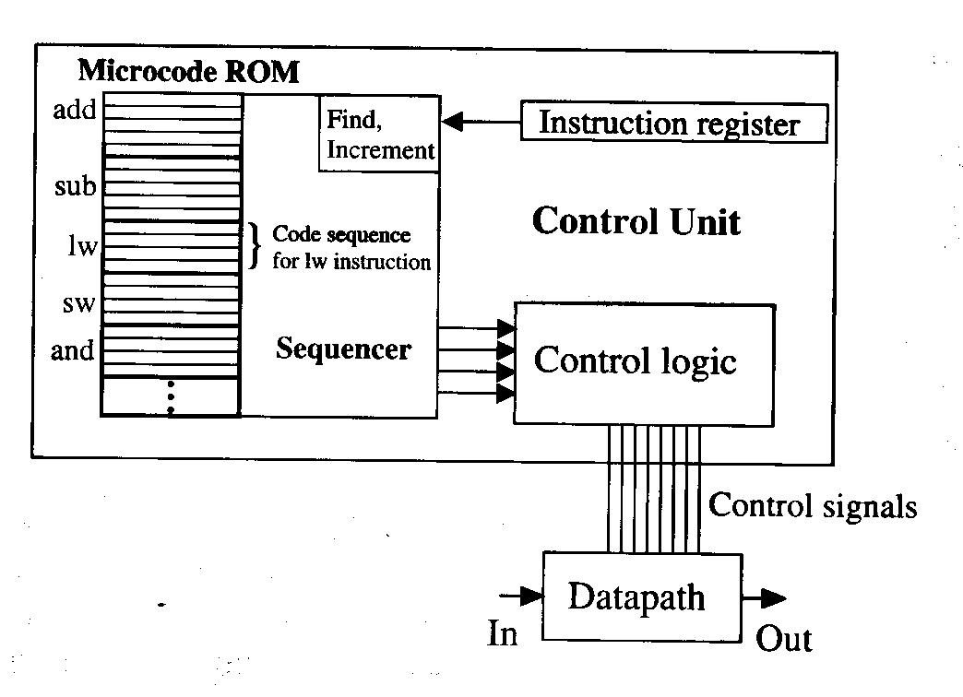
Block Diagram
An inst in the IR is sent to the sequencer which determines the location of the specified operation.
Then, sequencer executes the sequence of micro insts.

Slide 23
Pros and Cons
Pros:
  Powerful & flexible approach for increasing the inst set.
  Easy to program (compilation is also easy).
  Adding a new inst is easy.
  Modification to the inst set is also easy.
Cons:
  The internal sequencer circuit must be added to the unit.
  Each microinst requires a time t_{micro} to complete. So, each computer-level inst takes different clock cycles to complete.
  The hardware tends to grow in complexity with the richness of the microcode inst set.

Slide 24
RISC
Designed based on 80/20 rule: 80% of the program only uses 20% of the available insts.
Ex)
RISC concept:
  Only include the most useful insts in the datapath.
  Insure that the datapath yields fast execution of every instruction.
  Single-pass datapath: each unit in the datapath can only be accessed once during execution of an instruction.

Slide 25
Pros and Cons
Pros:
  The datapath can be optimized for the fastest throughput.
  Every inst takes the same amount of time (clock cycles).
  Only insts that can be completed in a single-pass through the data path are allowed.
Cons:
  Compliers must be optimized to produce efficient codes.
  Length of a program tends to be longer.

Slide 26
Floating-Point Operations
Arithmetic operations often require us to use fractional values (real numbers).
Ex)
In modern computers, a floating point representation is used to represent a real number using a binary bit pattern.
Basic expression:

Slide 27
32-Bit IEEE Single Precision FP Representation

Slide 28
64-Bit IEEE Double Precision FP Representation

Slide 29
Computing Speed
How to compare two computers?
  Choose a program of reasonable length and complexity.
  Run it on both systems.
  Compare the total execution times.
Ex) Suppose that two systems, x and y are given.

Slide 30
Another Performance Evaluation Concept
Instruction throughput = # insts processed per sec.
Ex)

Slide 31
Instruction Pipelining
Datapath consists of a number of individual components. They are used sequentially for each inst.
Ex)

Slide 32
Continued,

Slide 33
Program Completed
University of Missouri-Rolla
© 2003 Curators of University of Missouri

